Slide 1
Diffusion Language
Models 2
Diffusion Seminar (Week9)
Woojin Kim
AIDAS LAB
Seoul National University
wjk9904@snu.ac.kr

Slide 2
Table of contents
1
Recap: Discreteness of Text
2
Discrete Diffusion Modeling
3
Masked Diffusion Language Models
4
Unmasking & Token Ordering
5
Next week

Slide 3

Recap: Discreteness of Text

Slide 4
Why Diffusion Doesn’t Directly Work on Text
1. Discreteness of Text
Unlike images, text is made of discrete tokens
-> we can’t smoothly add noise like we do with pixels.
For text tokens
Text | Tokens
The cat sits on the mat | 0, 40, 43, 13, 2, 67
? ? ? ? ? ? | 0.5, 40.71, 42.1, 13.4, 1.8, 66.4
Rounding?
No image why on the love | 1, 41, 42, 13, 2, 66

Slide 5
Fragility of Semantics
1. Discreteness of Text
In images, a small perturbation in a single pixel (e.g., brown → red) is less noticeable and rarely changes the overall meaning.
In text, even a single token change (e.g., “a” → “b” or “cat” → “car”) can completely alter meaning and grammaticality.
“My cat ate a fish”
→ “My car ate b fish”
Thus, it’s harder for diffusion in text to ensure that noisy intermediate states map back to fluent, coherent sentences.

Slide 6
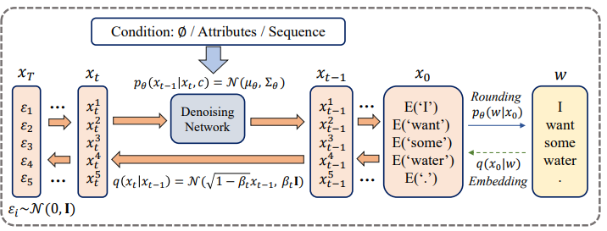
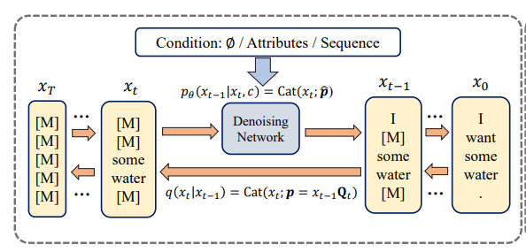
Dealing with Discreteness
1. Discreteness of Text
To apply diffusion to language, we need to bridge the gap between discrete tokens and the continuous noise-based diffusion framework.
Two main paradigms
Continuous Diffusion
Discrete Diffusion
https://www.ijcai.org/proceedings/2023/0750.pdf

Slide 7
Continuous VS. Discrete Diffusion
1. Discreteness of Text
Continuous Diffusion LM
Discrete Diffusion LM
Space
Embedding, Latent
Token
Noising process
Continuous noising
Masking, Replacing
Faster single-step operations (low-dim)
Classifier guidance
Image-based techniques are applicable
Works directly on tokens
Easier alignment with existing models
Simplified training objective
Pros
Training instability
Scaling to large corpora remains unproven
Requires encoder/decoder modules
Classifier guidance is limited
Transition itself is not differentiable
Cons

Slide 8
Discrete Diffusion Modeling

Slide 9
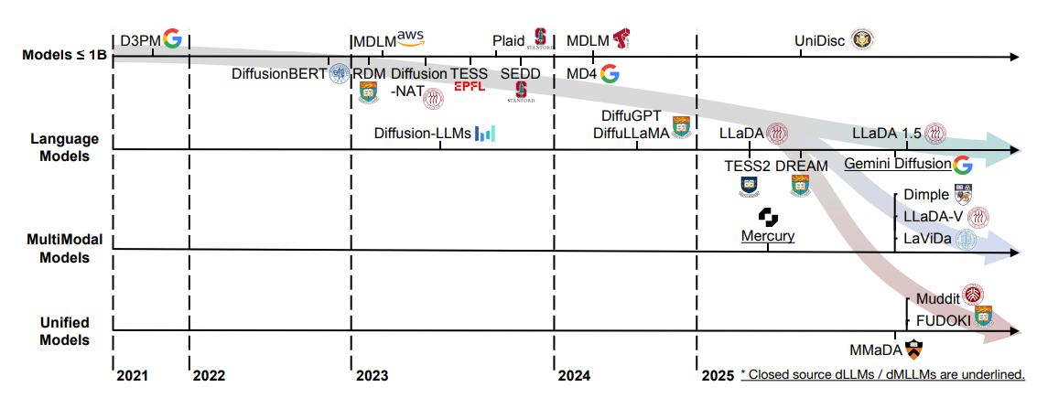
Evolution of Discrete Diffusion Language Models
2. Discrete Diffusion Modeling
Yu et al., “Discrete Diffusion in Large Language and Multimodal Models: A Survey”, 2025.

Slide 10
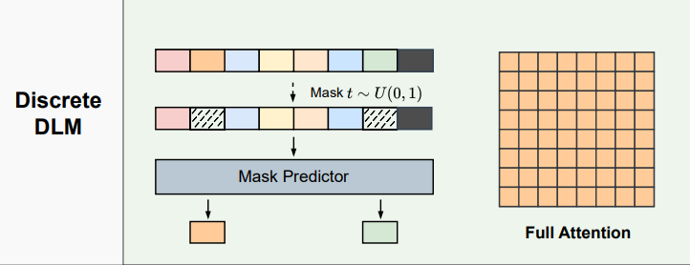
How can discrete data be modeled as a diffusion process?
2. Discrete Diffusion Modeling
Diffusion in continuous data: add Gaussian noise step-by-step.
The challenge with discrete data: Text tokens, categorical pixels, or symbolic data are non-continuous
Key idea: instead of Gaussian noise, use Markov transition matrices to corrupt data into noise.
https://www.ijcai.org/proceedings/2023/0750.pdf
Li et al., “A Survey on Diffusion Language Models”, 2025.

Slide 11



D3PM: Diffusion as Transitions in Discrete Space
2. Discrete Diffusion Modeling
Random variables with $K$ categories: $x_{t}∈1, …. K$
Define the forward transition probabilities by matrices:
$${{[Q}_{t}]}_{ij}=q\left(x_{t}=j \right| x_{t−1}=i )$$
Extend to one-hot version of $x$
$$q\left(x_{t} \right| x_{t−1})=Cat(x_{t};p=x_{t−1}Q_{t})$$
Categorical distribution over x given p
e.g. $K=3, p=\left[0.1,0.7,0.2\right]→sample with this probability$
Austin et al., “Structured Denoising Diffusion Models in Discrete State-Spaces”, NeurIPS 2021.

Slide 12




D3PM: Diffusion as Transitions in Discrete Space
2. Discrete Diffusion Modeling
Forward marginal
$$q\left(x_{t} \right| x_{0})=Cat\left(x_{t};p=x_{0}\overline{Q_{t}}\right) where \overline{Q_{t}}=Q_{1}Q_{2}…Q_{t}$$
Forward posterior
$$q\left(x_{t−1} \right| x_{t}, x_{0})= \frac{q\left(x_{t} \right| x_{t−1}, x_{0})q\left(x_{t−1} \right| x_{0})}{q\left(x_{t} \right| x_{0})}$$
$$=Cat\left(x_{t−1};p=\frac{x_{t}Q_{t}^{T}⊙x_{0}\overline{Q_{t−1}}}{x_{0}\overline{Q_{t}}x_{t}^{T}}\right)$$
$$\left(x_{t−1}Q_{t}\right)x_{t}^{T}=x_{t−1}\left(Q_{t}x_{t}^{T}\right)$$
$={(x}_{t}$ $Q_{t}^{T})x_{t−1}^{T}$
Austin et al., “Structured Denoising Diffusion Models in Discrete State-Spaces”, NeurIPS 2021.

Slide 13
D3PM: Diffusion as Transitions in Discrete Space
2. Discrete Diffusion Modeling
In continuous diffusion, the forward process is designed so that after many steps the distribution converges to a pure Gaussian.
Then, what should the transition in discrete diffusion satisfy?
Row stochasticity (probability conservation)
: Each row of $Q_{t}$​ must sum to 1.
2. Known stationary distribution
: The product $Q_{1}Q_{2}…Q_{T}$​ must converge to a fixed distribution as 𝑡→𝑇.
Austin et al., “Structured Denoising Diffusion Models in Discrete State-Spaces”, NeurIPS 2021.

Slide 14


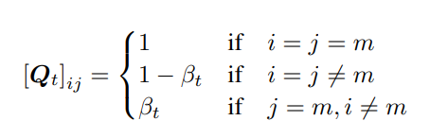

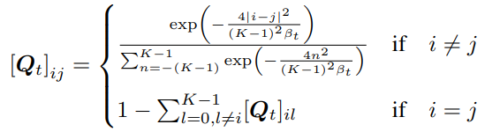
D3PM: Diffusion as Transitions in Discrete Space
2. Discrete Diffusion Modeling
Choice of Markov transition matrices
Uniform
Stationary is uniform
2. Absorbing state
Stationary is [MASK]
3. Discretized Gaussian
Stationary is uniform
Austin et al., “Structured Denoising Diffusion Models in Discrete State-Spaces”, NeurIPS 2021.

Slide 15
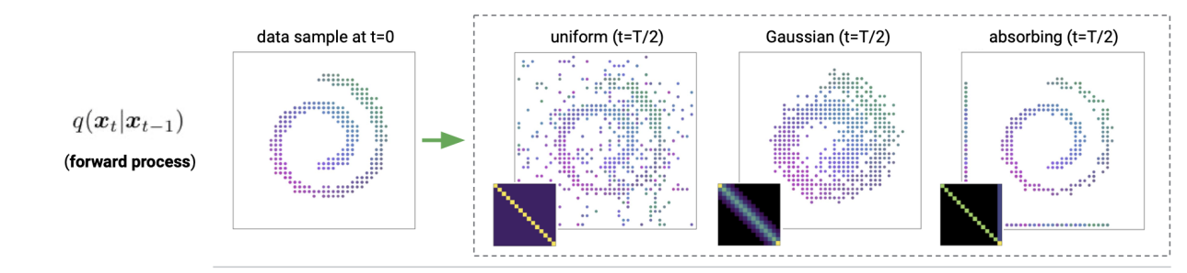
D3PM: Diffusion as Transitions in Discrete Space
2. Discrete Diffusion Modeling
Choice of Markov transition matrices
Austin et al., “Structured Denoising Diffusion Models in Discrete State-Spaces”, NeurIPS 2021.

Slide 16
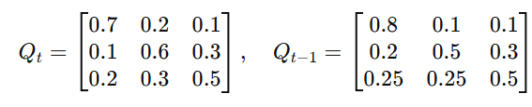
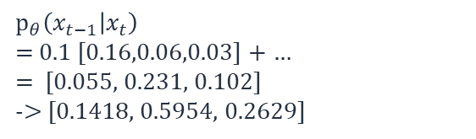

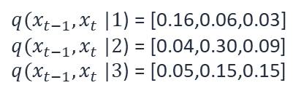



D3PM: Diffusion as Transitions in Discrete Space
2. Discrete Diffusion Modeling
Reverse process is formulated with $x_{0}\text{−}\text{parameterization}$
Recap: D3PM
-> Neural network predicts the logits of ${\tilde{p}}_{θ}(\tilde{x_{0}}|x_{t})$
$$q\left(x_{t−1} \right| x_{t}, x_{0})= \frac{q\left(x_{t} \right| x_{t−1}, x_{0})q\left(x_{t−1} \right| x_{0})}{q\left(x_{t} \right| x_{0})}$$
$=Cat\left(x_{t−1};p=\frac{x_{t}Q_{t}^{T}⊙x_{0}\overline{Q_{t−1}}}{x_{0}\overline{Q_{t}}x_{t}^{T}}\right)$
-> $p_{θ}\left(x_{t−1} | x_{t}\right)∝ \sum_{\tilde{x_{0}}}{q(x_{t−1}, x_{t}}|\tilde{x_{0}}){\tilde{p}}_{θ}(\tilde{x_{0}}|x_{t})$
Sampling process example
$x_{t}$ = [0 1 0]
${\tilde{p}}_{θ}\left(\tilde{x_{0}} | x_{t}\right)=$[0.1 0.6 0.3]
$$p_{θ}\left(x_{t−1} | x_{t}\right)$$
= 0.1 [0.16,0.06,0.03] + …
= [0.055, 0.231, 0.102]
-> [0.1418, 0.5954, 0.2629]
$q(x_{t−1}, x_{t}$ $|1$) = [0.16,0.06,0.03] $q(x_{t−1}, x_{t}$ $|2$) = [0.04,0.30,0.09]
$q(x_{t−1}, x_{t}$ $|3$) = [0.05,0.15,0.15]
Austin et al., “Structured Denoising Diffusion Models in Discrete State-Spaces”, NeurIPS 2021.

Slide 17
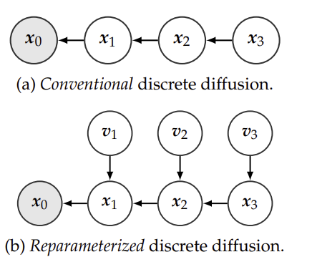

RDM: Reparameterized Discrete Diffusion Model
2. Discrete Diffusion Modeling
Backward process in D3PM is quite expensive: summing up over all possible $x_{0}$s
$$p_{θ}\left(x_{t−1} | x_{t}\right)∝ \sum_{\tilde{x_{0}}}{q(x_{t−1}, x_{t}}|\tilde{x_{0}}){\tilde{p}}_{θ}(\tilde{x_{0}}|x_{t})$$
Reparameterize the backward process into a routing mechanism:
Each token is either denoised (to ground truth) or reset to noise.
Introduces latent routing variables controlling token-level decisions.
Zheng et al., “A Reparameterized Discrete Diffusion Model for Text Generation”, COLM 2024.

Slide 18

RDM: Reparameterized Discrete Diffusion Model
2. Discrete Diffusion Modeling
Let the forward transition be:
$$q\left(x_{t} \right| x_{t−1})=β_{t}x_{t−1}+\left(1−β_{t}\right)q_{noise}$$
We can then derive the conditional backward transition as:
$$q\left(x_{t−1} \right| x_{t}, x_{0})= \left\{\begin{aligned}λ_{t−1}^{(1)}x_{t}+\left(1−λ_{t−1}^{(1)}\right)q_{noise} if x_{t}=x_{0} \\ λ_{t−1}^{(2)}x_{0}+\left(1−λ_{t−1}^{\left(2\right)}\right)q_{noise}\left(x_{t}\right) if x_{t}≠x_{0}\end{aligned}\right.$$
$if x_{t}=x_{0} →\text{Current} \text{state} \text{is} \text{well}\text{−}\text{formed} →\text{Remain} \text{at} x_{t} \text{or} \text{resets} \text{to} \text{noise}$
$if x_{t}≠x_{0} →\text{Current} \text{state} \text{is} \text{noisy} →\text{Denoise} \text{or} \text{remain} \text{noisy}$
Zheng et al., “A Reparameterized Discrete Diffusion Model for Text Generation”, COLM 2024.

Slide 19






RDM: Reparameterized Discrete Diffusion Model
2. Discrete Diffusion Modeling
Reparameterized Sampling
$$b_{t}=1_{x_{t}=x_{0}}$$
$$v_{t−1}^{(1)}\sim Bernoulli(λ_{t−1}^{\left(1\right)})$$
$x_{t−1}=b_{t}$[$v_{t−1}^{(1)}x_{t}+(1−v_{t−1}^{\left(1\right)})u_{t}^{\left(1\right)}]$
$$+(1−b_{t})\text{[}v_{t−1}^{(2)}x_{0}+(1−v_{t−1}^{\left(2\right)})u_{t}^{\left(2\right)}]$$
$$v_{t−1}^{(2)}\sim Bernoulli(λ_{t−1}^{\left(2\right)})$$
$${u_{t}^{(1)}\sim q}_{noise}$$
$${u_{t}^{\left(2\right)}\sim q}_{noise}(x_{t})$$
-> Simplified training objective & Efficient sampling
Zheng et al., “A Reparameterized Discrete Diffusion Model for Text Generation”, COLM 2024.

Slide 20
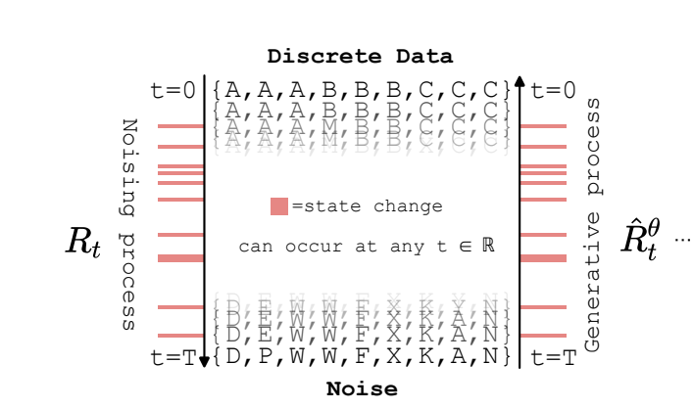

CTMC: Continuous Time Discrete Denoising Models
2. Discrete Diffusion Modeling
We have seen the continuous time formulation (ODEs, SDEs) of continuous diffusion models
Could discrete diffusion be extended to continuous time version?
CTMC: Continuous Time Markov Chain
-> Transition can occur at any time t
-> Transition is defined by the rate matrix $R_{t}(x, x^{′})$
instantaneous transition rates
Infinitesimal transition:
$$q_{t|t−∆t}\left(x^{′}\right| x)=δ_{x,x′}+R_{t}(x,x^{′})∆t$$
Campbell et al., “A Continuous Time Framework for Discrete Denoising Models”, NeurIPS 2022.

Slide 21


CTMC: Continuous Time Discrete Denoising Models
2. Discrete Diffusion Modeling
CTMC: Continuous Time Markov Chain
$$q_{t|t−∆t}\left(x^{′}\right| x)=δ_{x,x′}+R_{t}(x,x^{′})∆t$$
Reverse transition matrix:
$$\hat{R_{t}}\left(x, x^{′}\right)=R_{t}(x,x^{′})\sum_{x_{0}}{\frac{q_{t|0}\left(x^{′} | x_{0}\right)}{q_{t|0}\left(x | x_{0}\right)}q_{0|t}(x_{0}|x)}$$
$q_{0|t}\left(x_{0} | x\right):$ This is intractable -> parametrize by neural net $p_{θ}(x_{0} | x)$
Campbell et al., “A Continuous Time Framework for Discrete Denoising Models”, NeurIPS 2022.

Slide 22
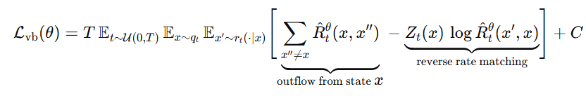


CTMC: Continuous Time Discrete Denoising Models
2. Discrete Diffusion Modeling
Train with continuous time ELBO
Inference with $τ$-leaping:
Instead of simulating every single jump event one by one, tau-leaping simulates all jumps over a time interval of length τ at once.
For a current state $x_{t},$ number of transitions to $x′$ during [t − τ, t] follows a Poisson distribution:
Campbell et al., “A Continuous Time Framework for Discrete Denoising Models”, NeurIPS 2022.
Yu et al., “Discrete Diffusion in Large Language and Multimodal Models: A Survey”, 2025.

Slide 23

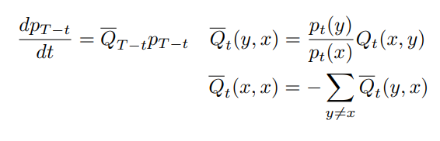


SEDD: Score Entropy Discrete Diffusion models
2. Discrete Diffusion Modeling
Standard diffusion relies on score matching (∇ log p(x)), well-defined in continuous spaces.
$$dx\left(t\right)=[−\frac{1}{2}β\left(t\right)x\left(t\right)−β\left(t\right)∇_{x}\log{q_{t}\left(x\left(t\right)\right)}]dt+ \sqrt{β\left(t\right)}d\overline{ω}(t)$$
Score Function
In discrete domains (e.g., text), the gradient is undefined → use concrete score:
CTMC ODE
Euler step
Reversal
Concrete Score
Lou et al., “Discrete Diffusion Modeling by Estimating the Ratios of the Data Distribution”, ICML 2024.

Slide 24
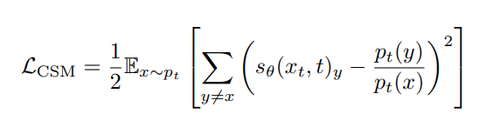
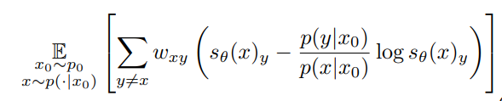

SEDD: Score Entropy Discrete Diffusion models
2. Discrete Diffusion Modeling
Concrete score matching
The ratio must be strictly positive; however, the L2 loss does not guarantee this.
Denoising score entropy
Enforce positivity -> training is stabilized
=
Choose $w_{xy}=Q_{t}(x_{t},y)$
Lou et al., “Discrete Diffusion Modeling by Estimating the Ratios of the Data Distribution”, ICML 2024.

Slide 25
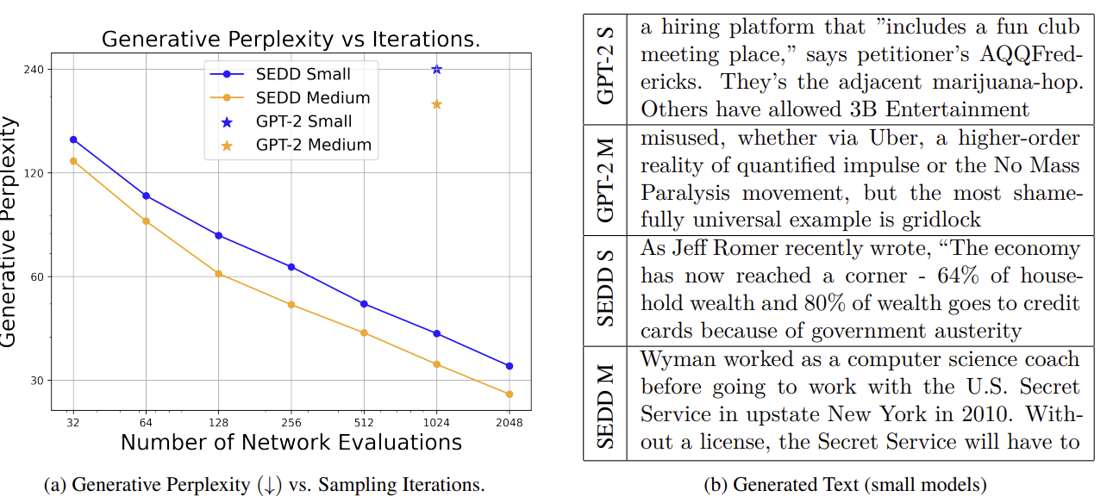
SEDD: Score Entropy Discrete Diffusion models
2. Discrete Diffusion Modeling
Lou et al., “Discrete Diffusion Modeling by Estimating the Ratios of the Data Distribution”, ICML 2024.

Slide 26
Masked Diffusion
Language Models

Slide 27

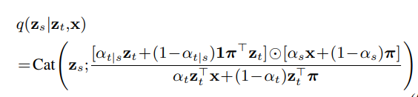



MDLM: Simple and Effective Masked Diffusion Language Models
3. Masked Diffusion Language Models
Assume random variable with K categories (one-hot)
K-th category is the [MASK] token, $m$ = one-hot vector for this mask
Define the forward process as the interpolation between clean data and target distribution
Clean data $x$
Recap: D3PM
Target Distribution $Cat(:,π)$
$$q\left(x_{t−1} \right| x_{t}, x_{0})= \frac{q\left(x_{t} \right| x_{t−1}, x_{0})q\left(x_{t−1} \right| x_{0})}{q\left(x_{t} \right| x_{0})}$$
$=Cat\left(x_{t−1};p=\frac{x_{t}Q_{t}^{T}⊙x_{0}\overline{Q_{t−1}}}{x_{0}\overline{Q_{t}}x_{t}^{T}}\right)$
Sahoo et al., “Simple and Effective Masked Diffusion Language Models”, NeurIPS 2024.

Slide 28

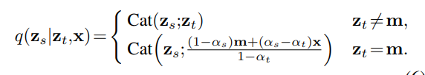

MDLM: Simple and Effective Masked Diffusion Language Models
3. Masked Diffusion Language Models
Masked Diffusion = Absorbing state diffusion
Target Distribution $Cat\left(:,π\right)→π=m$
Marginal of the forward
Posterior
Not masked yet
Interpolate between mask and the true data
Sahoo et al., “Simple and Effective Masked Diffusion Language Models”, NeurIPS 2024.

Slide 29
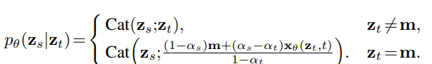
MDLM: Simple and Effective Masked Diffusion Language Models
3. Masked Diffusion Language Models
True posterior: is unknown (as usual)
Approximate with the model
Sahoo et al., “Simple and Effective Masked Diffusion Language Models”, NeurIPS 2024.

Slide 30



MDLM: Simple and Effective Masked Diffusion Language Models
3. Masked Diffusion Language Models
Requirements for the model
Zero Masking Probabilities
By definition, $<x,m> =0$
$$<x_{θ}(z_{t}, t),m> =0$$
Model should not predict <MASK> as output
2. Carry-Over Unmasking
If we have already unmasked the token, the model should not alter it
$$x_{θ}(z_{t}, t) =z_{t}$$
Sahoo et al., “Simple and Effective Masked Diffusion Language Models”, NeurIPS 2024.

Slide 31
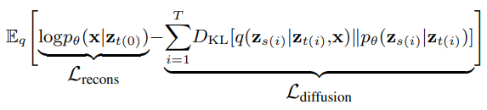
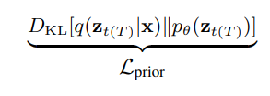

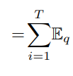
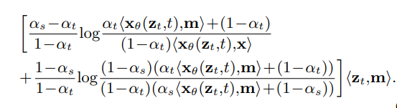

MDLM: Simple and Effective Masked Diffusion Language Models
3. Masked Diffusion Language Models
Loss function
Original ELBO
D3PM loss
Sahoo et al., “Simple and Effective Masked Diffusion Language Models”, NeurIPS 2024.

Slide 32


MDLM: Simple and Effective Masked Diffusion Language Models
3. Masked Diffusion Language Models
Loss function
D3PM loss
$$<x_{θ}(z_{t}, t),m> =0$$
MDLM loss (Rao-Blackwellization)
Sahoo et al., “Simple and Effective Masked Diffusion Language Models”, NeurIPS 2024.

Slide 33
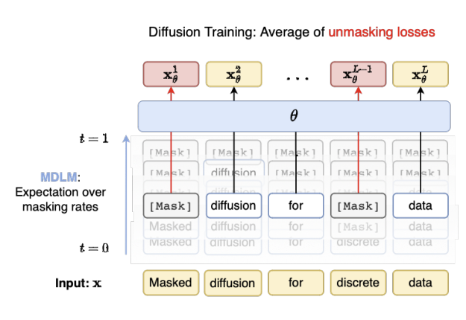

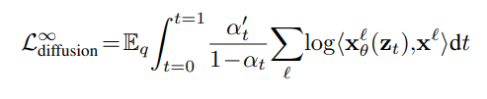


3. Masked Diffusion Language Models
MDLM: Simple and Effective Masked Diffusion Language Models
Continuous time formulation
Sending $T→∞$
Masked diffusion language model
Sequence of $x^{1:L}$
Weighted average of MLM loss!
Campbell et al., “A Continuous Time Framework for Discrete Denoising Models”, NeurIPS 2022.

Slide 34

RADD: Reparameterized Absorbing Discrete Diffusion
3. Masked Diffusion Language Models
Recall: Continuous time formulation of discrete diffusion model
CTMC ODE
Euler step
Reversal
Concrete Score
For multi-dimensional setting (length d), score becomes (considering the cases when only 1 tokens are changed):
Ou et al., “YOUR ABSORBING DISCRETE DIFFUSION SECRETLY MODELS THE CONDITIONAL DISTRIBUTIONS OF CLEAN DATA”, ICLR 2025.

Slide 35
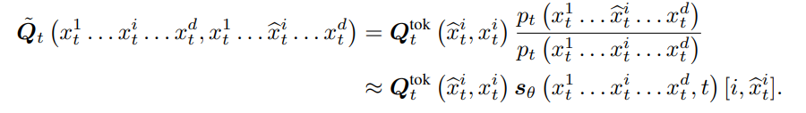


RADD: Reparameterized Absorbing Discrete Diffusion
3. Masked Diffusion Language Models
The reverse transition rate matrix then becomes:
Note that for masked diffusion, only the transition from the masked token to an unmasked token is valid
Ou et al., “YOUR ABSORBING DISCRETE DIFFUSION SECRETLY MODELS THE CONDITIONAL DISTRIBUTIONS OF CLEAN DATA”, ICLR 2025.

Slide 36
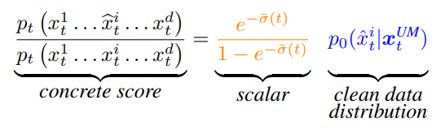
RADD: Reparameterized Absorbing Discrete Diffusion
3. Masked Diffusion Language Models
Then, we can express the concrete score a time-independent conditional distribution at time zero multiplied by an analytic time-dependent term
Removes time dependency
Enables caching
Ou et al., “YOUR ABSORBING DISCRETE DIFFUSION SECRETLY MODELS THE CONDITIONAL DISTRIBUTIONS OF CLEAN DATA”, ICLR 2025.

Slide 37
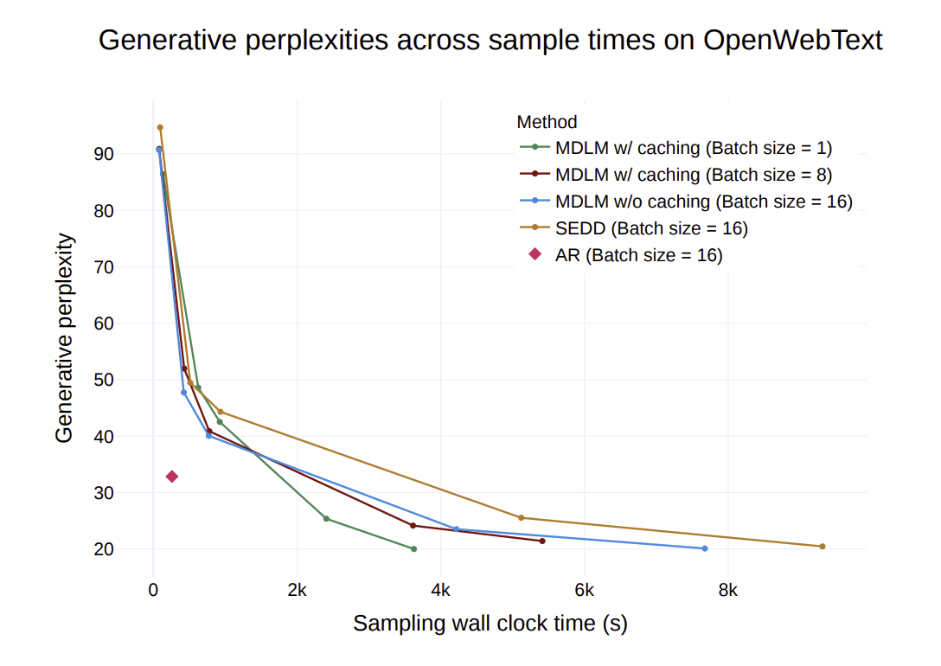
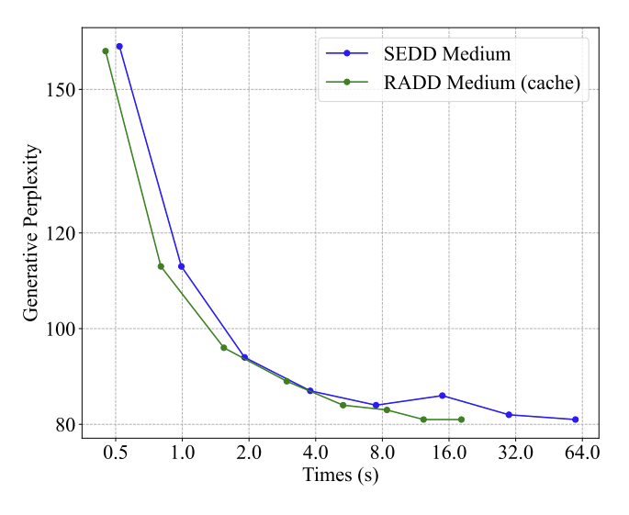
RADD: Reparameterized Absorbing Discrete Diffusion
3. Masked Diffusion Language Models
MDLM
RADD
Ou et al., “YOUR ABSORBING DISCRETE DIFFUSION SECRETLY MODELS THE CONDITIONAL DISTRIBUTIONS OF CLEAN DATA”, ICLR 2025.

Slide 38
Unmasking
& Token Ordering

Slide 39
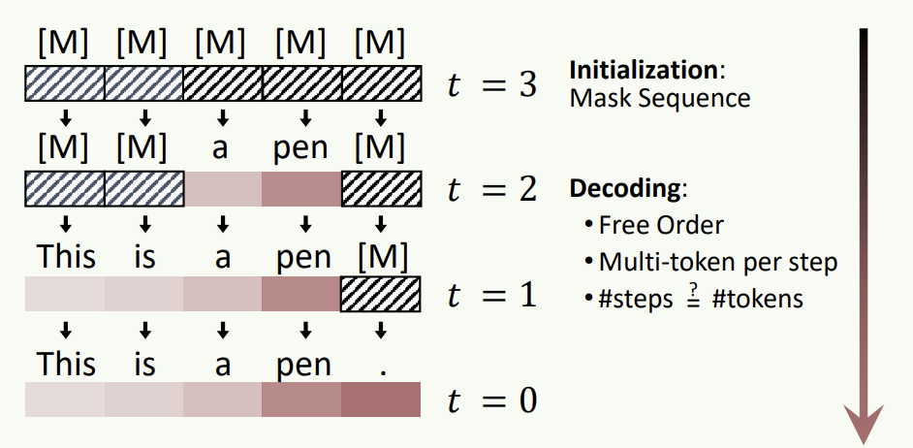
Unmasking
4. Unmasking & Token Ordering
Discrete diffusion can decode many tokens at once, since it operates over the entire sequence simultaneously.
However, because unmasked tokens are often unchanged afterward, it is unclear whether unmasking all tokens is always beneficial.
Yu et al., “Discrete Diffusion in Large Language and Multimodal Models: A Survey”, 2025.

Slide 40
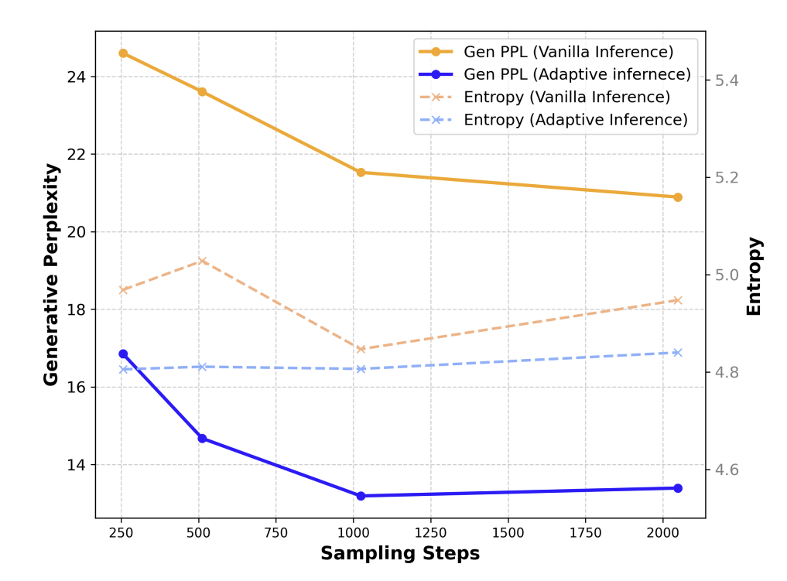
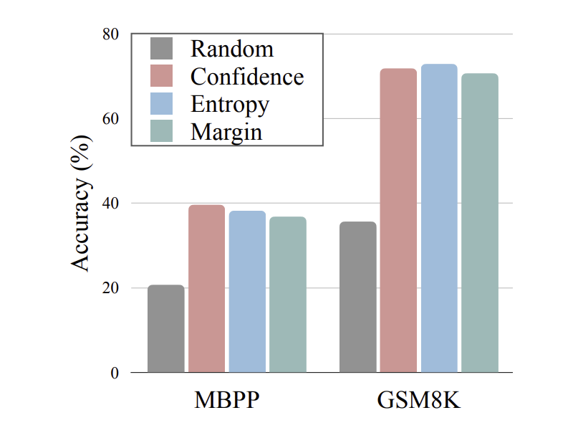
Order Matters
4. Unmasking & Token Ordering
Recent works in discrete diffusion show that the unmasking strategy has a significant impact on performance..
This raises the question of token ordering—specifically, which tokens should be prioritized and unmasked earlier versus later.
Kim et al., “Train for the Worst, Plan for the Best: Understanding Token Ordering in Masked Diffusions”, ICML 2025.
Ben-Hamu et al., “Accelerated Sampling from Masked Diffusion Models via Entropy Bounded Unmasking”, 2025.

Slide 41
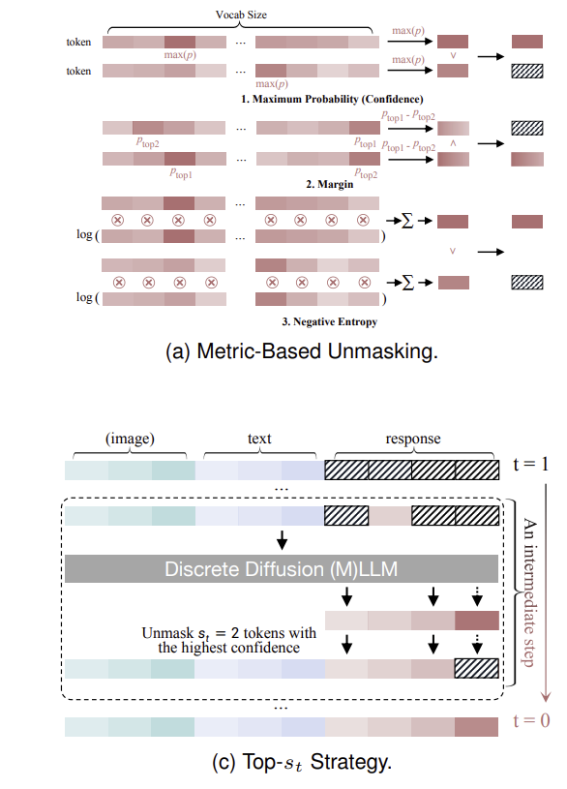
How to unmask?
4. Unmasking & Token Ordering
Then the questions are:
Based on what criteria should we unmask?
2. And how much should be unmasked?
Yu et al., “Discrete Diffusion in Large Language and Multimodal Models: A Survey”, 2025.

Slide 42
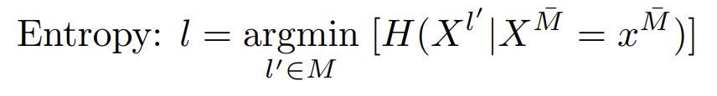
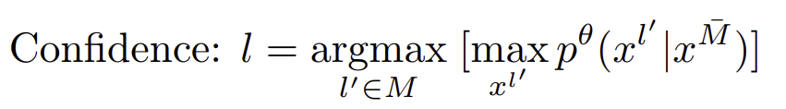
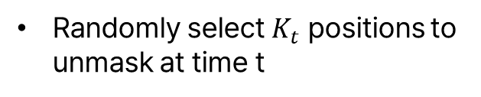
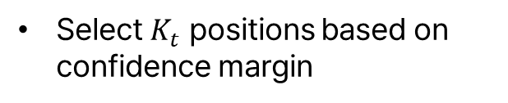
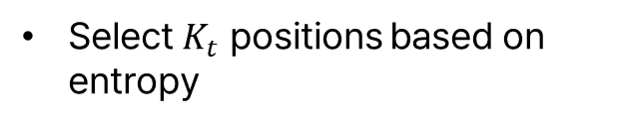
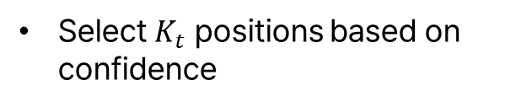
Criteria for Unmasking
4. Unmasking & Token Ordering
1. Random
3. Entropy (Dream, 2025)
Randomly select $K_{t}$ positions to unmask at time t
Select $K_{t}$ positions based on entropy
2. Confidence (SMDM, 2025)
4. Margin (Kim et al., 2025)
Select $K_{t}$ positions based on confidence
Select $K_{t}$ positions based on confidence margin
Ben-Hamu et al., “Accelerated Sampling from Masked Diffusion Models via Entropy Bounded Unmasking”, 2025.

Slide 43
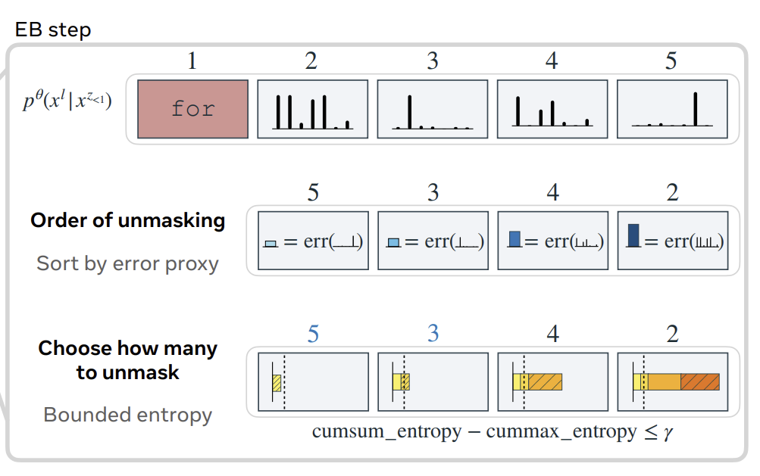
Selecting K
4. Unmasking & Token Ordering
1. Top-K
Unmask a fixed number of tokens at each step
2. Confidence threshold (Dimple, 2025)
Dynamically unmask all tokens above a fixed confidence threshold
3. Adaptive (EB-Sampler, 2025)
Adjust the number of tokens unmasked per step based on an entropy bound, unmasking more when the model is confident
Ben-Hamu et al., “Accelerated Sampling from Masked Diffusion Models via Entropy Bounded Unmasking”, 2025.

Slide 44
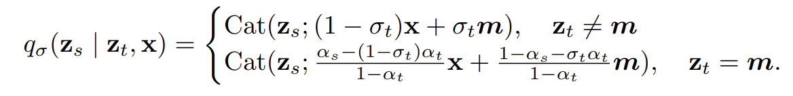
Remasking
4. Unmasking & Token Ordering
Then, beyond unmasking newly generated tokens, we may also wish to revisit previously unmasked tokens.
MDLM
ReMDM
Wang et al., “Remasking Discrete Diffusion Models with Inference-Time Scaling”, 2025.

Slide 45
Next week
Week 8
Diffusion Language
Models Ⅲ
AR VS. NAR
AR-like formulation in DLMs
Block-wise diffusion
Week 9
Diffusion Language
Models IV
Recent advances in DLM
Scaling, Reasoning
KV-caching, distillation

Slide 46
More on this…
Discrete diffusion modeling
Austin et al., “Structured Denoising Diffusion Models in Discrete State-Spaces”, NeurIPS 2021.
Hoogebum et al., “Autoregressive Diffusion Models”, ICLR 2022.
CTMC / Concrete score matching / Ratio matching
Campbell et al., “A Continuous Time Framework for Discrete Denoising Models”, NeurIPS 2022.
Meng et al., “Concrete Score Matching: Generalized Score Matching for Discrete Data”, NeurIPS 2022.
Lou et al., “Discrete Diffusion Modeling by Estimating the Ratios of the Data Distribution”, ICML 2024.
Ou et al., “YOUR ABSORBING DISCRETE DIFFUSION SECRETLY MODELS THE CONDITIONAL DISTRIBUTIONS OF CLEAN DATA”, ICLR 2025.
Haxholi et al., “EFFICIENT PERPLEXITY BOUND AND RATIO MATCHING IN DISCRETE DIFFUSION LANGUAGE MODELS ”, ICLR 2025.

Slide 47
More on this…
Masked diffusion language modeling
He et al., “DiffusionBERT: Improving Generative Masked Language Models with Diffusion Models”, ACL 2023.
Zhou et al., “Diffusion-NAT: Self-Prompting Discrete Diffusion for Non-Autoregressive Text Generation”, EACL 2024.
Zheng et al., “A Reparameterized Discrete Diffusion Model for Text Generation”, COLM 2024.
Sahoo et al., “Simple and Effective Masked Diffusion Language Models”, NeurIPS 2024.
Nie et al., “Scaling up Masked Diffusion Models on Text”, ICLR 2025.
Nie et al., “Large Language Diffusion Models”, 2025.
Gong et al., “Scaling Diffusion Language Models via Adaptation from Autoregressive Models”, ICLR 2025.
Uniform state diffusion language modeling
Schiff et al., “Simple Guidance Mechanisms for Discrete Diffusion Models”, ICLR 2025.
Sahoo et al., “The Diffusion Duality”, ICML 2025.
Unmasking & Token ordering
Kim et al., “Train for the Worst, Plan for the Best: Understanding Token Ordering in Masked Diffusions”, ICML 2025.
Ben-Hamu et al., “Accelerated Sampling from Masked Diffusion Models via Entropy Bounded Unmasking”, 2025.

Slide 48


